Slide 1

Heart Disease: A Machine Learning Approach
Amanda, Charity, Sergio

Slide 2

Predicting Heart Disease
Our goal is to utilize machine learning models on a dataset of patient information to predict whether a person has heart disease.

Slide 3
Agenda
Introduction
Extracting Data
Transforming/
Cleaning Data
Logistic Regression model
Using KerasTuner
Primary goals

Slide 4
Extracting Data
4 Databases
Cleveland, Hungary , Switzerland, Va Long Beach
Cleveland Data extracted from Repo
Remaining from .DATA file
Combined All into 1 CSV file

Slide 5
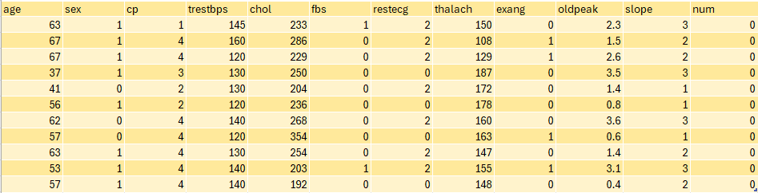
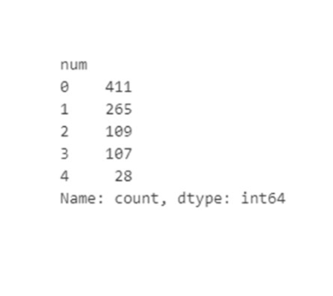
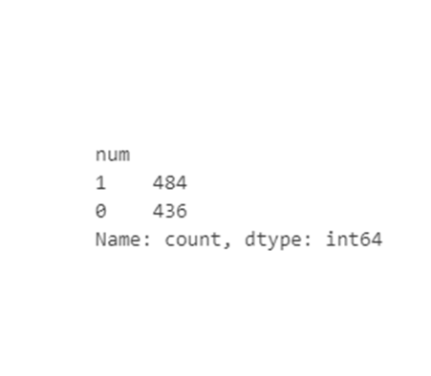
Contains 920 Rows & 14 Columns
All appear to be multivariate type of datasets
Original
Binary

Slide 6
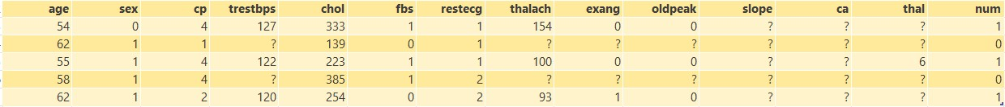
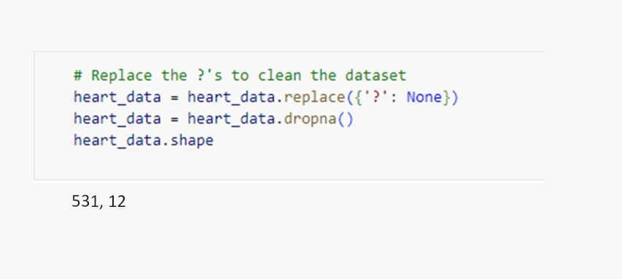
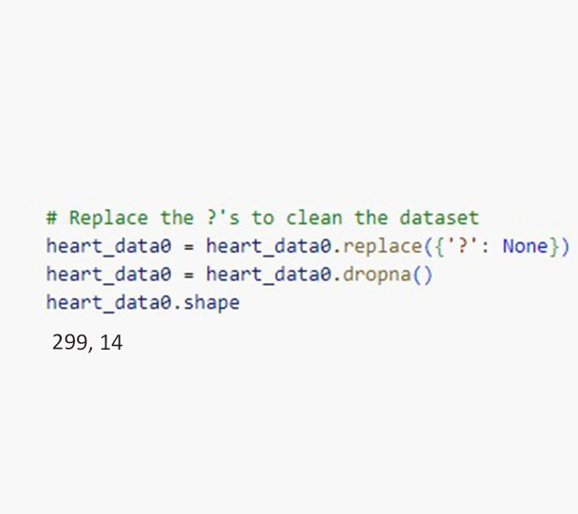
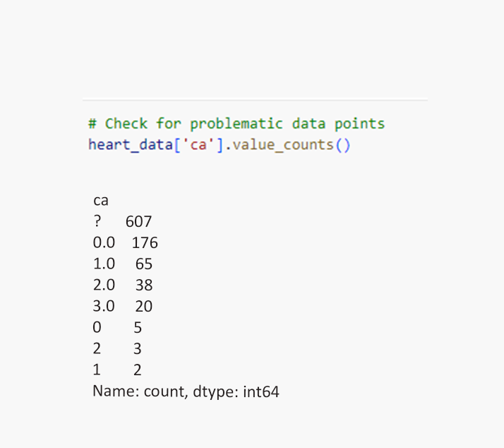
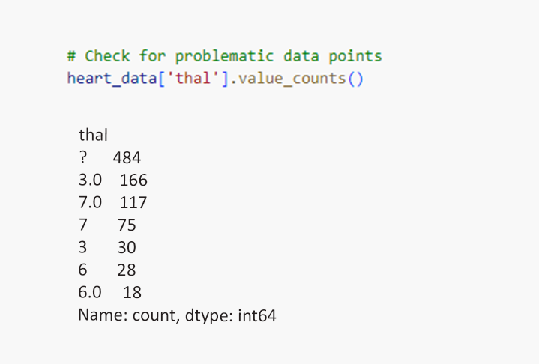
Transforming/Cleaning Data

Slide 7
Logistic Regression Model Data Preparation
Connecting to PostgreSQL database
Moved continuous variables into new table
+ categorical columns
encoding as dummies to complete data
Converting Boolean variables to Binary

Slide 8
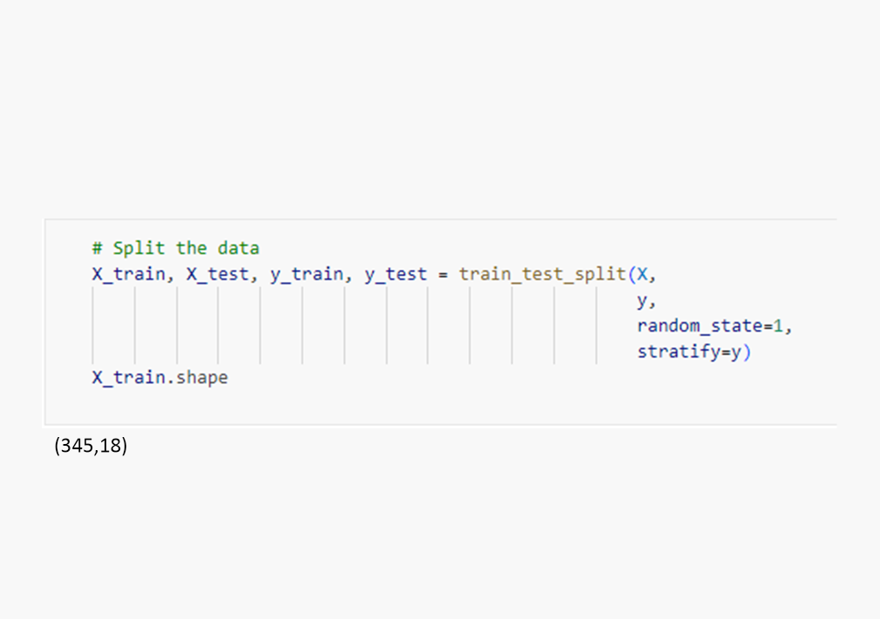
Training & Testing Data
Split Data
Performance on unseen data
Y Represents the target variable (num)
X Contains Remaining Features
75% of data is used for training
25% of remaining data is used for testing

Slide 9



Creating Logistic Regression Model
Specifying Parameters
Solver set for optimization
Maximum Iterations
Setting random state for reproducibility
Fit Model Using Training Data
Learning from Patterns
Understanding how Features relate to target Variable
Make Predictions Using Testing Data
Model used to predict testing data
Target Variable predicted based on what model learned
Shows how well model preforms on unseen data

Slide 10

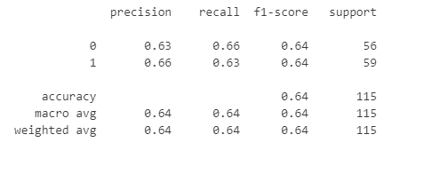
Evaluate the model's performance
Confusion Matrix
Classification Report
Shows
True Positives 37
True Negative 19
False Positives 22
False Negatives 37
Model Performance Summary

Slide 11
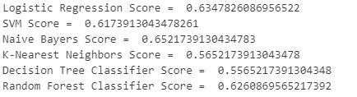
Classifier Models
Data Preparation
Train- Test Split
Define Models
Model Training
Model Evaluation
Separate the target variable ('Heart Disease') from the features.
Split the data into training and testing sets with a ratio of 75% training and 25% testing.
Use stratified sampling to maintain the same proportion of classes in both sets.
Create a dictionary containing various classification models to evaluate.
Iterate through each model and train them using the training data.
Iterate through each model
Make predictions on the test set.
Calculate accuracy score.
Print the model's name and its accuracy score.

Slide 12
Using KerasTuner
Method that creates a new Sequential model with Hyperparameter options
1
Let Kerastuner decide which activation function to use in hidden layers
2
Kesrastuner to decide number of neurons in first layers
3
Allow Kerastuner to decide number of hidden layers & Neurons in hidden layers
4
Compile the Model
5

Slide 13
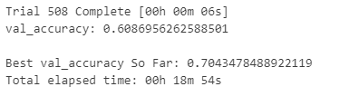
Search for best Hyperparameters
Train model for 100 Epochs using our Training data while validating it on our Test data.
Helps optimize models' performance by exploring different combinations

Slide 14
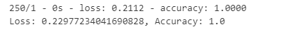
Evaluate Best Model Against Full Test Data
Our model retrieves the best model from the tuner
Evaluates its performance on the scaled test
Prints out the loss accuracy metrics

